Slide 1
CSE 237B Spring 2016
Justin Gergen
Ali Ghorbani

Slide 2
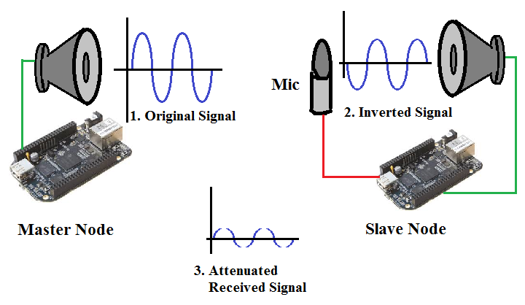
Synchronized Chirp Cancellation

Slide 3
Synchronized Chirp Cancellation - Open Loop
X

Slide 4
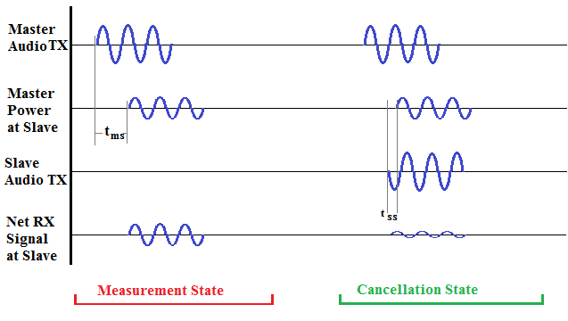
Synchronization and Cancellation

Slide 5
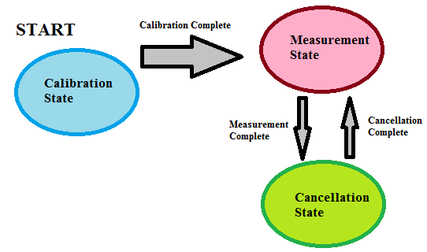
State Machine

Slide 6
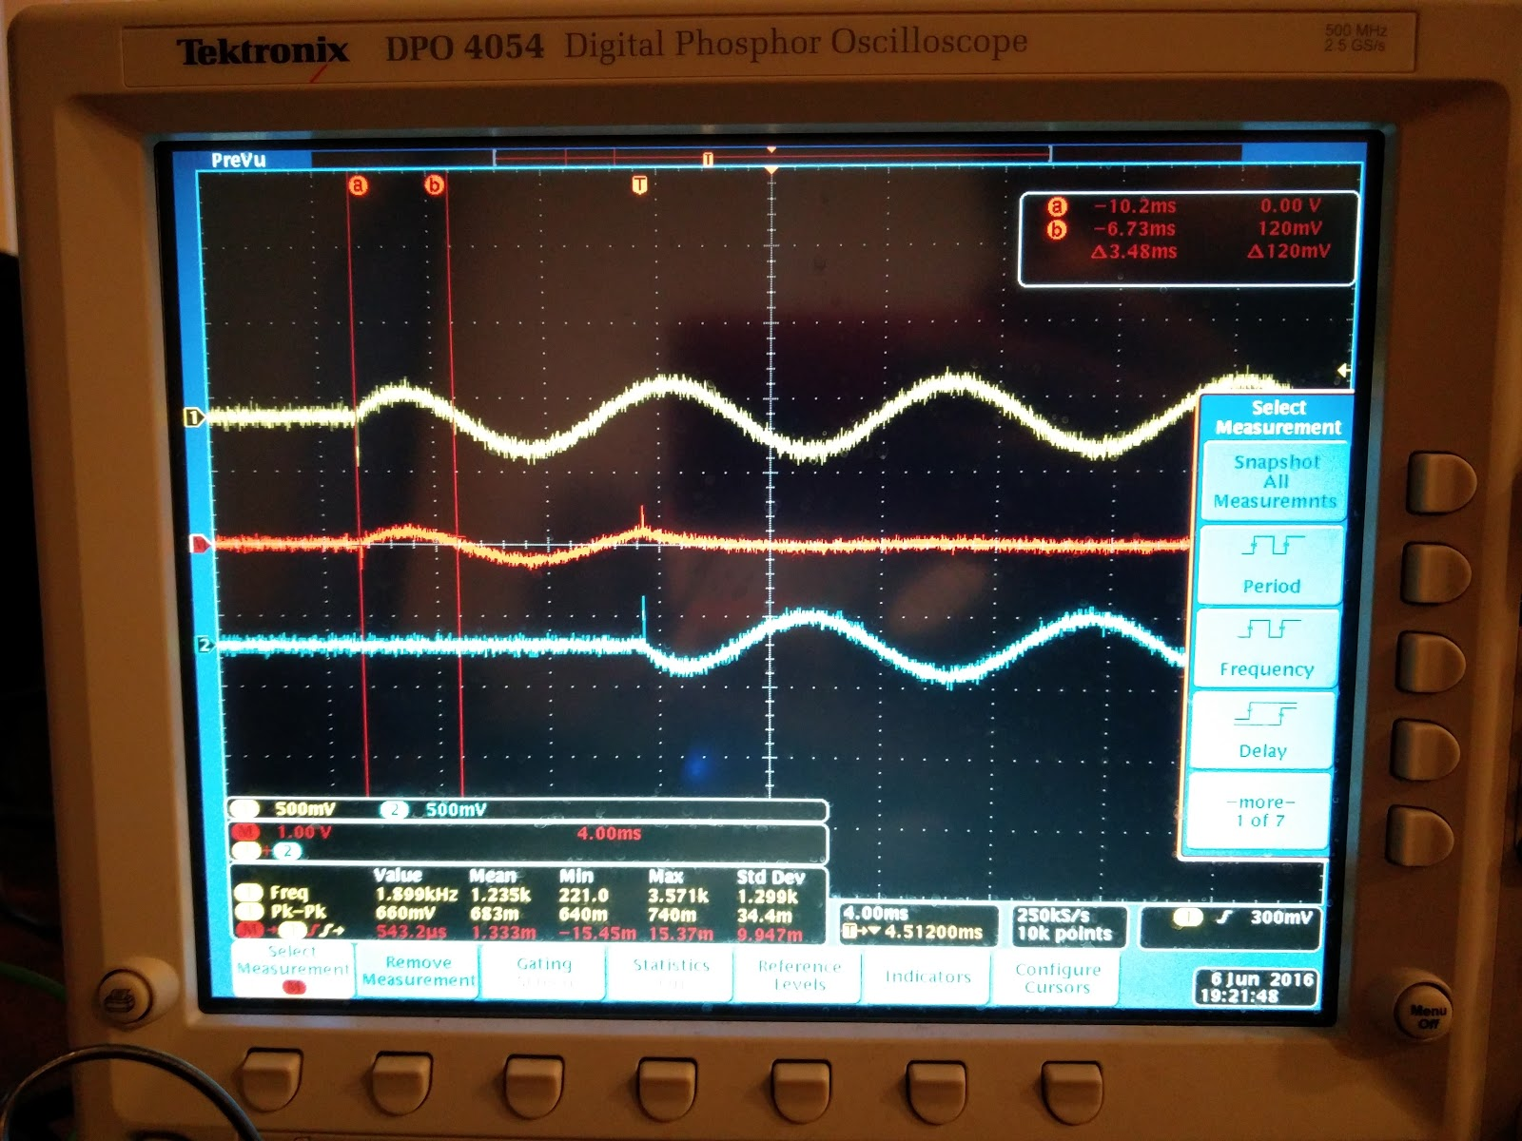
Timing performance, Cancellation
Cancellation was achieved by Electrically summing the signals
Cancellation performance is very Sensitive to synchronization Performance
Should be able to cancel <100 Hz sounds with 3 ms stdDev
Mean (ms) | StdDev (ms)
1.2 | 3.8

Slide 7
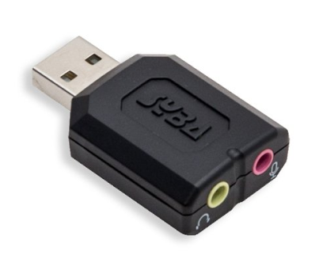
Challenges
Analog input sampling is challenging
Software Polling of ADC with usleep is problematic for audio
Large amounts of jitter when trying to sample at 48kHz
Frequent dropouts of 10-500 milliseconds
Solution: Use USB audio device … not a good solution
Requires USB audio drivers
No built-in audio support in golang, used wrapper for portaudio19-dev from github
Does NOT truly support simultaneous microphone and speaker
Kernel panics

